Slide 1



Mantle Cell Lymphoma (MCL)
Pharma Intelligence
Market Spotlight
Publication Date: April 2024
www.datamonitorhealthcare.com

Slide 2
Key Takeaways
Datamonitor Healthcare estimates that in 2023, there were approximately 16,590 incident cases of mantle cell lymphoma (MCL) worldwide, and forecasts that number to increase to 18,010 incident cases by 2026.
It is estimated that the majority of diagnosed cases are in males.
The incidence of MCL is highest among older individuals aged 60+ years.
Approved drugs in the MCL space focus on a wide variety of targets. The majority of these drugs are administered via the oral or intravenous route, with one product also being available in a subcutaneous formulation.
The greatest proportion of industry-sponsored drugs in active clinical development for MCL are in Phase II.
Therapies in active clinical development for MCL focus on a wide variety of targets. These drugs are administered via the oral and intravenous routes.
High-impact upcoming events for drugs in the MCL space comprise topline Phase III trial results for Calquence, an expected PDUFA date for Breyanzi, and an estimated Japanese approval decision for Jayprica.
The overall likelihood of approval of a Phase I MCL asset is 8.3%, and the average probability a drug advances from Phase III is 33.3%. Drugs, on average, take 7.2 years from Phase I to approval, compared to 10.0 years in the overall oncology space.
The distribution of clinical trials across Phase I–IV indicates that the vast majority of trials for MCL have been in the early and mid-phases of development, with 94% of trials in Phase I–II, and only 6% in Phase III–IV.
The US has a substantial lead in the number of MCL clinical trials globally. France leads the major European markets, while China has the top spot in Asia.

Slide 3
Key Takeaways
Bristol Myers Squibb has the highest number of completed clinical trials for MCL, with 36 trials.
Bristol Myers Squibb leads industry sponsors with the highest overall number of clinical trials for MCL, closely followed by Roche.

Slide 4
Table of Contents
Disease Background and Treatment
Epidemiology
Drug Landscape
  Marketed Drugs
  Pipeline Drugs
  Recent Events and Analyst Opinion
  Key Upcoming Events
  Key Regulatory Events
  Probability of Success
  Revenue Opportunity
Clinical Trial Landscape

Slide 5
Disease Background and Treatment

Slide 6
Disease Background
Disease definition
Mantle cell lymphoma (MCL) is a rare form of B-cell non-Hodgkin’s lymphoma (NHL) which accounts for about 5% of all NHLs. MCL is considered incurable and has a median survival rate of 3–5 years. MCL is caused by a malignant change in the B lymphocytes found in the outer region of a lymph node follicle known as the mantle zone. These transformed cells grow and divide uncontrollably, leading to lymph node enlargement. The lymphoma cells can invade the bloodstream and the lymphatic channels, thereby spreading to other lymph nodes (e.g., adenoids and tonsils) and organs or tissues such as the liver, spleen, bone marrow, and gastrointestinal tract. Other sites, such as the lacrimal glands, lungs, skin, and the central nervous system (CNS), may also be affected. In 30–50% of patients, more than two extranodal sites are involved. Almost all MCL patients have a characteristic t(11;14)(q13;q32) chromosomal translocation which causes an excessive production of cyclin D1, a protein that triggers cancer cell division and growth. On rare occasions, MCL is caused by overexpression of other genes such as cyclin D2 or D3. However, overexpression of transcription factor SOX11 is seen in nearly all MCL cases, irrespective of the presence of cyclin D1.
There are four main histopathological variants of MCL, which have distinct disease courses. Most patients present with classical MCL, but other subtypes include the small cell, pleomorphic, and blastoid variants. The pleomorphic and blastoid variants are associated with a poor prognosis. The blastoid variant, in particular, which accounts for an estimated 10–15% of MCL cases, has frequent extranodal involvement and often responds poorly to commonly used treatments. Patients may present with the blastoid variant, or it may emerge as the disease progresses over time.
Source: Fakhri and Kahl, 2017; Herrero-Vicent et al., 2016; Khanna et al., 2017; Leukemia & Lymphoma Society, 2018; Lynch et al., 2021; McKay et al., 2018; Shrestha et al., 2015

Slide 7
Disease Background
Patient segmentation
MCL is most commonly staged according to the Lugano Modification of the Ann Arbor staging system. Within this system, patients with limited disease are classified as either Stage I or Stage II. Stage I patients have involvement of only one node or a group of adjacent nodes, while Stage II patients have two or more nodal groups on the same side of the diaphragm. Stage II patients can also be categorized as “bulky,” depending on the disease extent. Additionally, some patients can be given “E” designations based on their extranodal status. Patients with a single extranodal lesion without nodal involvement are classified as Stage IE, whereas Stage I/II patients with limited contiguous extranodal involvement are classified as Stage IIE. Advanced patients are segmented into Stage III and Stage IV. Patients who either have affected nodes on both sides of the diaphragm or affected nodes above the diaphragm with spleen involvement are categorized as Stage III. Any patients with additional non-contiguous extralymphatic involvement are considered as Stage IV.
Symptoms
The symptoms of MCL are in some ways similar to the symptoms of other NHL subtypes. The most common symptom of MCL is one or more swollen lymph nodes in the neck, armpit, or groin. Patients with MCL may experience fever, night sweats, appetite and weight loss, nausea and/or vomiting, abdominal pain or bloating, indigestion, fatigue due to anemia, a pain or pressure in the lower back region that radiates down to either one or both legs, or a discomfort or sensation of fullness caused by enlarged tonsils, spleen, or liver. On rare occasions, MCL also spreads to the CNS, causing various neurological symptoms including dizziness, headaches, and confusion.
Source: Cheson et al., 2014; Leukemia & Lymphoma Society, 2018; Lymphoma Action, 2021; NORD, 2021

Slide 8
Disease Background
Risk factors
The biggest risk factors associated with MCL are age and gender. MCL is more common in older people, with the average age at diagnosis being in the mid-60s, and compared to women, men are more likely to develop the disease. Race is also a potential risk factor, with Caucasian individuals having a higher risk of developing MCL. The risk of MCL has been linked with infections caused by European strains of the spirochete Borrelia burgdorferi, especially when manifesting as acrodermatitis atrophicans. A Scandinavian case-control study showed that individuals with a history of Borrelia infection were 2–3 times more likely to develop MCL, but not other NHL types. However, this outcome has not been confirmed by subsequent independent studies.
Other risk factors which have been associated with NHL in general include lifestyle factors (high body mass index, smoking, and high alcohol intake), occupational factors (exposure to pesticides and solvents), medication with immune suppressants, exposure to viruses (Epstein-Barr virus, hepatitis B, hepatitis C, and human herpes virus-8), and a family history of hematopoietic malignancies.
Diagnosis
Initial workup for MCL patients may include physical examination, evaluation of patient medical history, performance status assessment, and identification of symptoms that suggest MCL. Laboratory tests including complete blood count, serum lactate dehydrogenase measurements, and beta-2 microglobulin level testing may also help in diagnosing the disease. However, a final diagnosis of MCL must be based on analysis of affected tissue obtained via surgical biopsy. Determination of either cyclin D1 overexpression by immunohistochemistry examination or t(11;14)(q13;q32) by fluorescence in situ hybridization is generally essential for disease diagnosis. Cyclin D1 is overexpressed in about 95% of MCL cases. In rare cyclin D1-negative cases, detection of SOX11 overexpression may be useful in establishing the diagnosis.
Source: Cheah et al., 2016; GARD, 2016; Leukemia & Lymphoma Society, 2018; Wang and Ma, 2014

Slide 9
Disease Background
Immunophenotyping using flow cytometry can be useful to identify the proteins that are present on the surface of lymphoma cells. The markers CD5, CD19, CD20, CD22, CD79a, CD43, and FMC7 are typically positive, and CD10, CD23, CD200, and BCL6 are typically negative for MCL cases. Imaging tests, such as CT or PET scans, of the thorax, abdomen, and pelvis are commonly performed to determine the extent and location of the disease.
Source: Cheah et al., 2016; Leukemia & Lymphoma Society, 2018; Lymphoma Action, 2021

Slide 10
Treatment
MCL is a heterogeneous disease, and the treatment approach must be determined on an individual basis. The choice of treatment for MCL depends on various factors such as the disease stage, cell variant, patient age and general health status, and disease-related symptoms. MCL is usually diagnosed after it has disseminated to various regions of the body, and therefore most patients require immediate treatment following diagnosis. However, a small subset of asymptomatic patients with indolent MCL, or patients with a good performance score and prognosis, may not require immediate treatment. These patients are usually recommended for watchful waiting, which includes regular health checkups and imaging tests to monitor the cancer. This strategy helps to maintain patients’ overall health and quality of life while carefully watching for disease progression. However, treatment of MCL patients should start once symptoms or signs of disease progression appear. Treatment approaches are divided along two lines: younger, fitter patients receive intensive treatment; whereas less fit, older patients receive non-intensive therapies. There are no standard treatments for MCL; however, various treatment approaches are available, which include aggressive chemoimmunotherapy followed by consolidation therapy using autologous stem cell transplantation (SCT) or maintenance therapy with Rituxan (rituximab) for young, fit patients. For older MCL patients, conventional chemoimmunotherapy followed by Rituxan as a maintenance therapy is usually recommended.
Targeted therapies
Targeted therapies target specific biomarkers in order to kill cancer cells while imparting minimal damage to healthy cells. Rituxan is a monoclonal antibody which binds to the CD20 antigen found on the surface of lymphoma cells, causing cell death either directly or indirectly. Although it is not approved by the US Food and Drug Administration (FDA), the drug is the backbone of many regimens used in the first-line treatment of MCL, and it is also used as maintenance therapy to prolong remission after induction treatment.
Source: Leukemia & Lymphoma Society, 2018; Lymphoma Research Foundation, 2021; Maddocks, 2018; Martin et al., 2017; Nazeef and Kahl, 2015; NCCN, 2021

Slide 11
Treatment
Other targeted therapies used for MCL treatment include kinase inhibitors and proteasome inhibitors. Kinases are a large group of enzymes that perform various cell functions such as controlling cell growth, and kinase inhibitors block the activity of these enzymes. The FDA has approved the Bruton’s tyrosine kinase (BTK) inhibitors Imbruvica (ibrutinib), Calquence (acalabrutinib), and Brukinsa (zanubrutinib) for the treatment of patients with MCL who have received at least one prior therapy. In addition to these, the FDA approved Jaypirca (pirtobrutinib) in January 2023 for the treatment of adult patients with relapsed/refractory MCL who have received at least two lines of systemic therapy, including a BTK inhibitor. Proteasome inhibitors block the action of proteasomes, which causes proteins to accumulate within cells, leading to apoptosis of both healthy cells and cancer cells. Velcade is a proteasome inhibitor approved by the FDA for the treatment of MCL and can be used in conjunction with chemotherapy drugs.
Chemotherapies
Chemotherapies are cytotoxic drugs used to kill cancer cells, usually by stopping their ability to grow and multiply, and are most often combined with Rituxan and/or steroids for first-line MCL treatment. Rituxan plus cyclophosphamide, doxorubicin, prednisone, and vincristine, which is usually regarded as the R-CHOP regimen, is one of the most commonly used chemoimmunotherapy regimens in MCL. Aggressive regimens used in fit patients include R-DHAP (Rituxan, dexamethasone, and cytarabine) + platinum therapy (carboplatin, cisplatin, or oxaliplatin), alternating R-CHOP/R-DHAP, the NORDIC regimen (intensified R-CHOP alternating with Rituxan plus cytarabine), the hyper-CVAD + Rituxan regimen (cyclophosphamide, vincristine, doxorubicin, and dexamethasone alternating with methotrexate and cytarabine, with continuous Rituxan), and BR (Treanda/Bendeka [bendamustine] and Rituxan) followed by Rituxan and high-dose cytarabine.
Treanda/Bendeka plus Rituxan is commonly recommended as a less aggressive first-line treatment for older or unfit patients. Other less aggressive chemoimmunotherapy regimens include VR-CAP (Velcade [bortezomib], Rituxan, cyclophosphamide, doxorubicin, and prednisone) and R-BAC (Rituxan, Treanda/Bendeka, and cytarabine).
Source: Cancer Research UK, 2020; FDA, 2017; FDA, 2019; FDA, 2023; Leukemia & Lymphoma Society, 2018; Lymphoma Research Foundation, 2021; NCCN, 2021

Slide 12
Treatment
Steroids
Steroids are naturally occurring substances produced by the body that are usually used to reduce inflammation. They have a toxic effect on lymphoma cells and have strong anticancer properties. Steroids are often combined with chemotherapy for the treatment of MCL. Prednisone, methylprednisolone, and dexamethasone are some of the steroids used in MCL treatment.
Immunomodulators
Immunomodulatory drugs modulate immune system activity to slow down the growth of tumor cells, resulting in the reduction of cell numbers. Revlimid (lenalidomide) is approved by the FDA for the treatment of patients with relapsed or treatment-resistant MCL. It is usually combined with Rituxan as a less aggressive first-line therapy, or used with or without Rituxan as a treatment for relapsed/refractory patients.
Radiation therapy
This therapy uses high-energy X-rays to damage the DNA in lymphoma cells, which either kills the cancer cells or inhibits the formation of new cancer cells. Radiation therapy can benefit patients with localized MCL, and it enables the de-escalation of systemic therapies. For patients who are frail, radiation alone can be a good option. Involved site radiation therapy can be used for the treatment of MCL that is limited in extent. Radiation can be an effective palliative therapy in advanced stages of the disease and a salvage therapy for relapsed MCL.
Source: Ben Barouch et al., 2020; Cancer Research UK, 2020; NCCN, 2023

Slide 13
Treatment
CAR T-cell therapy
Chimeric antigen receptor T-cell (CAR-T) therapy is a method of treatment in which T cells from the patient’s body are removed and a chimeric antigen receptor is added to them in a laboratory, thereby genetically modifying the T cells to find and kill cancer cells. This therapy may be used as a third-line treatment for MCL after chemoimmunotherapy and targeted therapy have proved inadequate. In July 2020, the FDA approved the CD19 CAR-T therapy Tecartus (brexucabtagene autoleucel) for the treatment of patients with relapsed/refractory MCL.
Stem cell transplantation
SCT procedures replace damaged or destroyed hematopoietic stem cells with healthy stem cells. There are two kinds of SCTs: autologous and allogeneic. Autologous SCT uses a patient’s own healthy stem cells, whereas allogeneic SCT utilizes donor stem cells. The main objective of SCT is to improve a patient’s response to initial therapy and extend the remission period. For young and fit patients who are asymptomatic and have no co-morbidities, high-dose chemotherapy along with autologous SCT can help to achieve a complete remission. SCT is one of the few potentially curative treatment approaches for MCL patients; however, it also carries a risk of serious complications, especially allogeneic SCT. Reduced-intensity allogeneic transplants may help avoid some of these complications in select patients.
Source: FDA, 2020; Leukemia & Lymphoma Society, 2018; Lymphoma Research Foundation, 2021; NCCN, 2023

Slide 14
Epidemiology

Slide 15
Epidemiology
Incidence
Methodology
Datamonitor Healthcare used historical incidence data to estimate and forecast the global incidence of MCL in the United Nations (UN) world regions (World, Africa, Asia, Europe, Latin America and the Caribbean, Northern America, and Oceania) between 2017 and 2026.
There is a lack of recent, high-quality epidemiological literature describing MCL incidence and regional variation. To determine incidence at regional and global level, Datamonitor Healthcare undertook data analysis using two sources. Incidence rates from the US National Program of Cancer Registries public use dataset were calculated using the most recent five years of data available (2011–15) using SEER*Stat software, by gender and age group (Centers for Disease Control and Prevention, 2018; National Cancer Institute, 2018). The corresponding US incidence rates were assumed to equal those in the Northern America region. To capture regional variation, Datamonitor Healthcare utilized data from Cancer Today, provided by the International Agency for Research on Cancer (Ferlay et al., 2018). Regional NHL incidence data were extracted for the regions described above, and region-specific ratios with reference to the Northern America incidence rates were calculated. Datamonitor Healthcare made the assumption that regional variation in NHL would be approximately equal to that of MCL, which is a subtype of NHL. Also, Datamonitor Healthcare made the assumption that the age group- and gender-specific incidence structure is consistent across regions. In this way, age group- and gender-specific incidence rates were estimated at the global and regional level.
To calculate the number of incident cases of MCL in the 2017–26 forecast period, Datamonitor Healthcare multiplied the incidence proportions by the gender-, age-, and region-specific population estimates from the UN World Population Prospects database. The UN database was chosen as a reliable population denominator; the data include standard sets of demographic indicators. Incidence rates were held constant across the forecast period.
Included are estimated incident cases of MCL during 2017–26, and age group- and gender-specific incident cases for 2017.

Slide 16
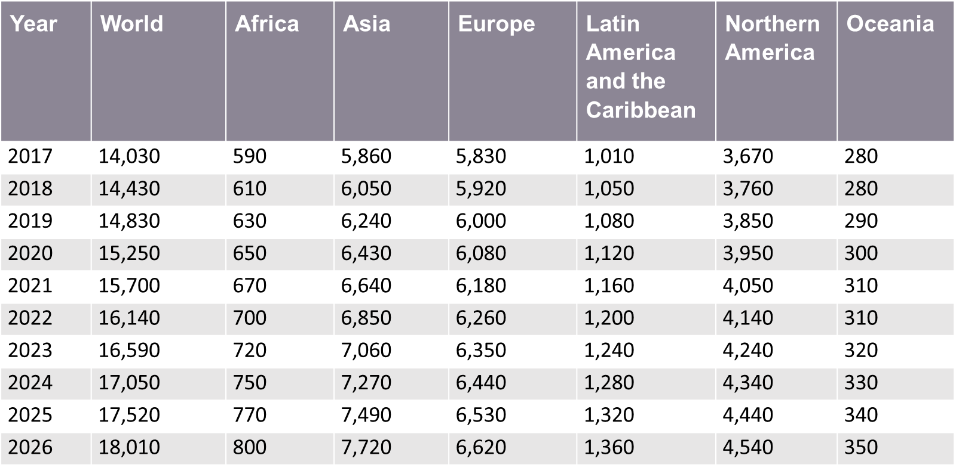
Global Incident Cases of Mantle Cell Lymphoma, 2017–26
Note: World incident cases has a world-specific incidence applied to the UN world population estimate and is not a sum of all regions.
Datamonitor Healthcare estimates that in 2023, there were approximately 16,590 incident cases of MCL worldwide.
Datamonitor Healthcare forecasts the number of incident cases to increase to 18,010 cases by 2026.
Asia is estimated to have had the largest number of incident cases in 2023 (7,060 cases), while the Oceania region is estimated to have had the smallest number (320 cases).
Source: Datamonitor Healthcare; Centers for Disease Control and Prevention, 2018; Ferlay et al., 2018; National Cancer Institute, 2018; United Nations, 2017

Slide 17
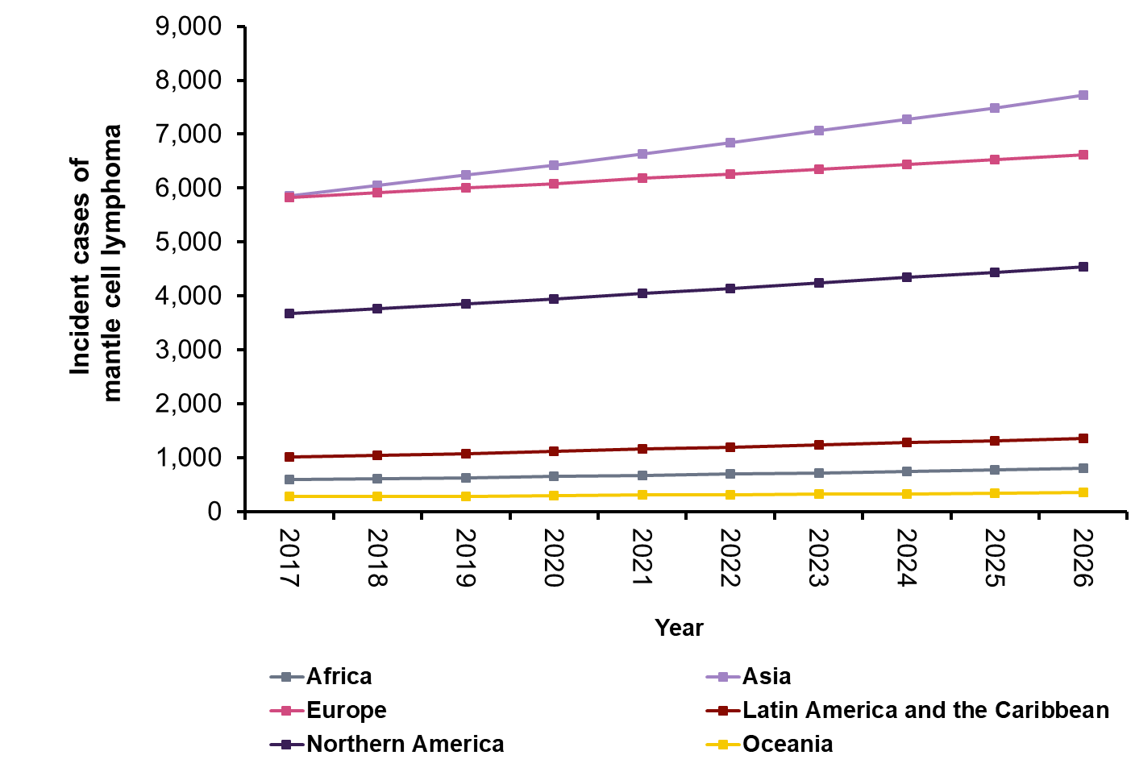
Global Trends in Incident Cases of Mantle Cell Lymphoma, 2017–26
Globally, the number of incident cases of MCL is expected to increase by 28.4% between 2017 and 2026.
These trends are driven by population demographics, as incidence proportions were held constant throughout the forecast period.
Source: Datamonitor Healthcare; Centers for Disease Control and Prevention, 2018; Ferlay et al., 2018; National Cancer Institute, 2018; United Nations, 2017

Slide 18
Global Incident Cases of Mantle Cell Lymphoma, by Gender, 2017
Note: totals may not sum due to rounding.
Globally, the incidence of MCL is higher in males (10,150 cases) compared to females (3,870 cases). This is true for all regions.
At a global level, it is estimated that 72.34% of diagnosed cases were male in 2017.
Source: Datamonitor Healthcare; Centers for Disease Control and Prevention, 2018; Ferlay et al., 2018; National Cancer Institute, 2018; United Nations, 2017

Slide 19
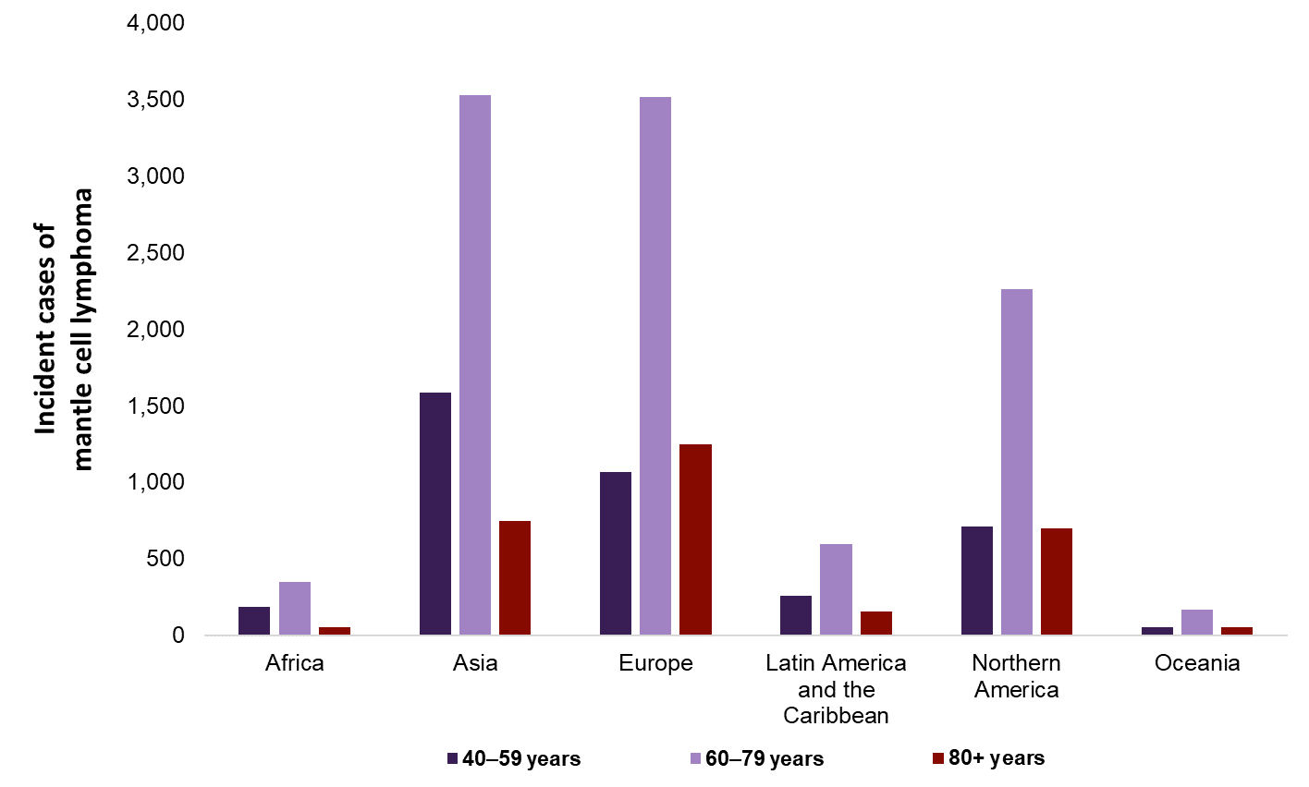
Global Incident Cases of Mantle Cell Lymphoma, by Age, 2017
Worldwide, the incidence of MCL is highest among older individuals; incidence proportions are highest among those aged 60+ years. Across all regions, the highest proportion of cases in 2017 were aged 60–79 years at diagnosis.
Source: Datamonitor Healthcare; Centers for Disease Control and Prevention, 2018; Ferlay et al., 2018; National Cancer Institute, 2018; United Nations, 2017

Slide 20
Drug Landscape

Slide 21
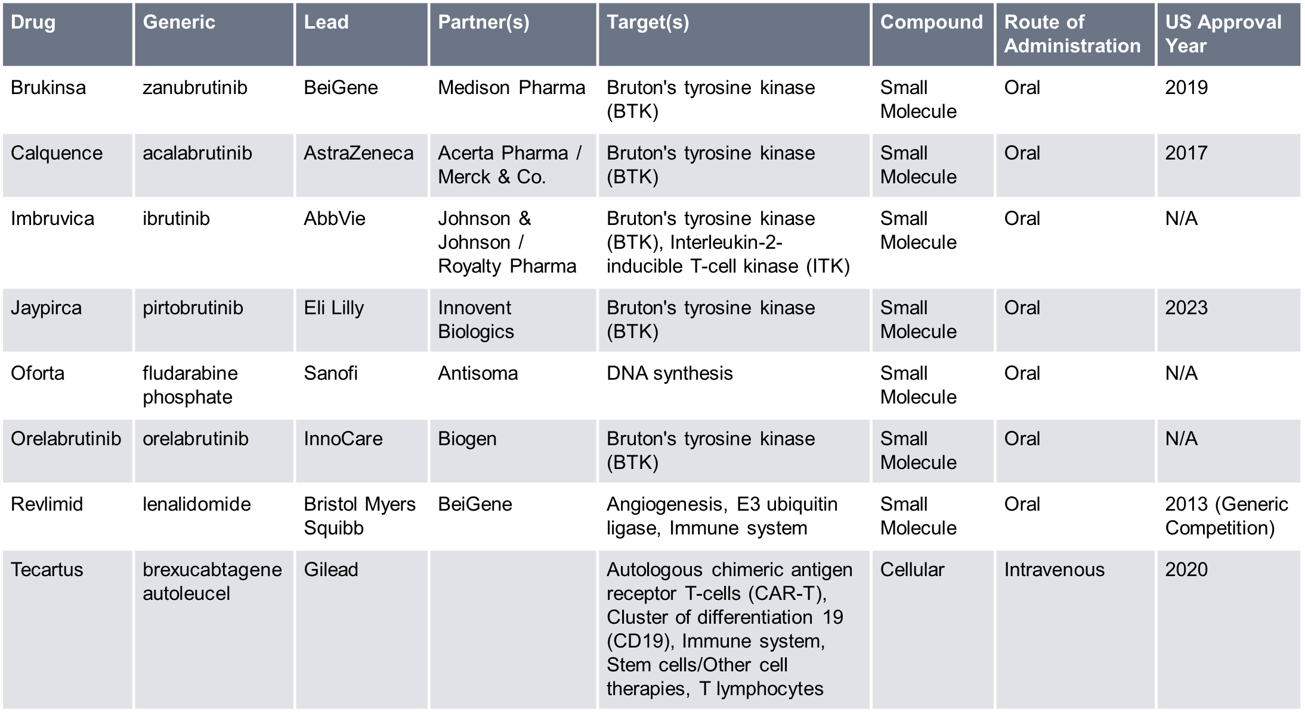
Marketed Drugs
This is a snapshot of approved drugs in the MCL space in the curated Biomedtracker database. Approved drugs in the MCL space focus on a wide variety of targets. The majority of these drugs are administered via the oral or intravenous route, with one product also being available in a subcutaneous formulation.
Source: Biomedtracker 22 March 2024

Slide 22
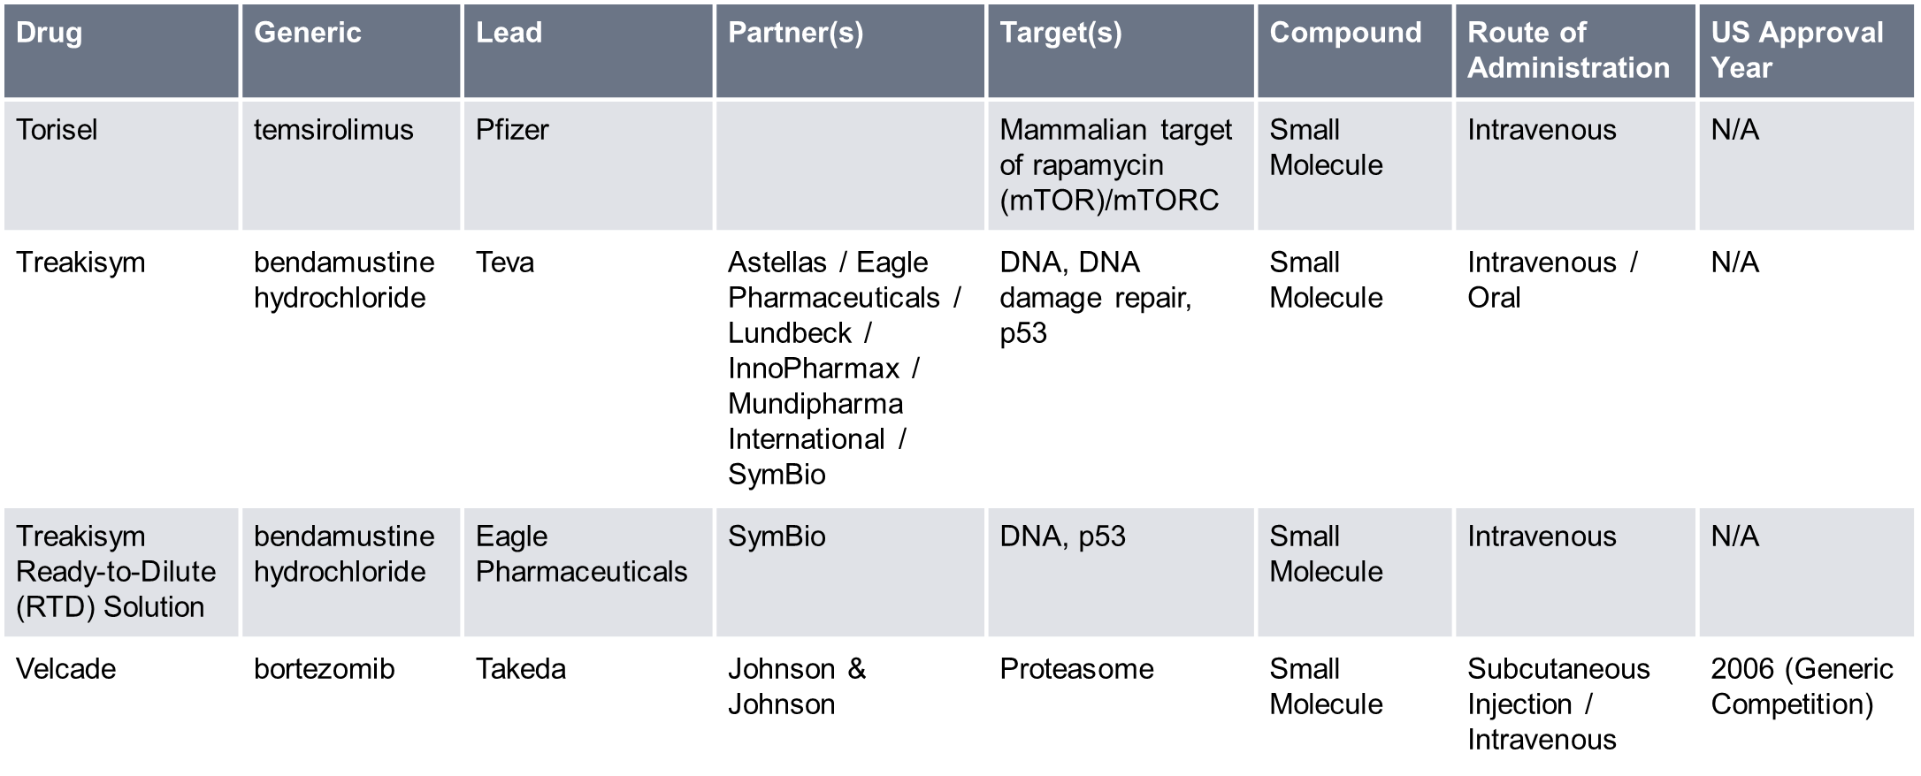
Marketed Drugs
Source: Biomedtracker 22 March 2024

Slide 23
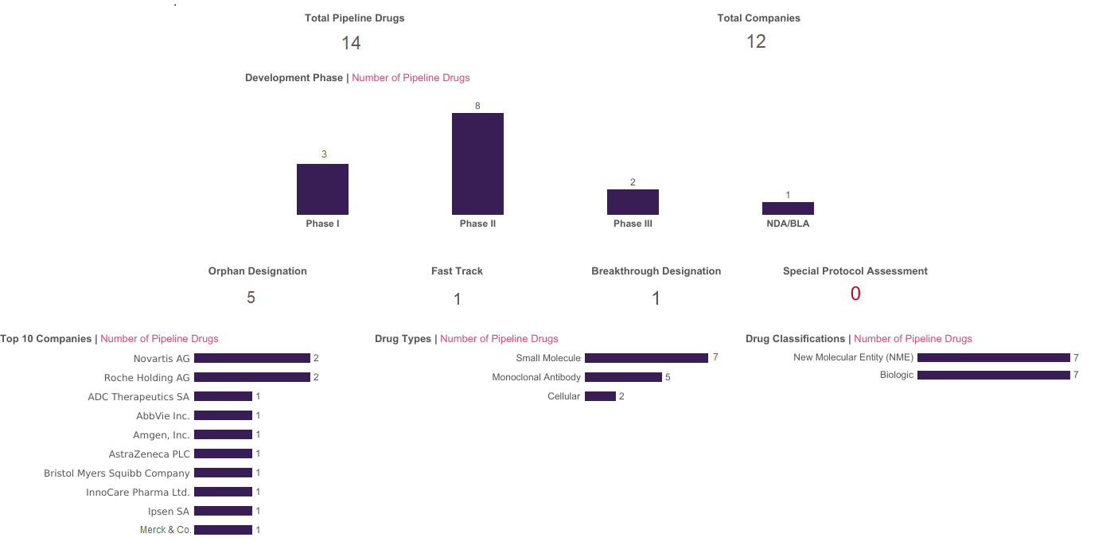
Pipeline Drugs in the US
This is a snapshot of Phase I–III and New Drug Application (NDA) or Biologics License Application (BLA) candidate drugs in the MCL space in the curated Biomedtracker database. The greatest proportion of industry-sponsored drugs in active clinical development for MCL are in Phase II. Preclinical, Investigator Initiated, and Investigational New Drug (IND) candidates are not included here. Phase I/II and Phase II/III are counted as Phase II and Phase III, respectively.
Source: Biomedtracker 22 March 2024

Slide 24
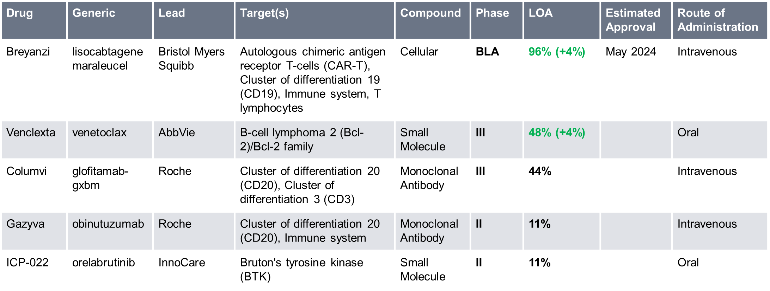
Pipeline Drugs in the US
This is a snapshot of Phase I–III and NDA or BLA candidate drugs in the MCL space in the curated Biomedtracker database. Therapies in active clinical development for MCL focus on a wide variety of targets. These drugs are administered via the oral and intravenous routes.
Likelihood of Approval (LOA) refers to the chance of FDA approval of an NDA or BLA. The average chance of FDA approval for marketing in the US for the specified disease was based on the historical performance of drugs in the same development phase as per a 2003–13 analysis of the Biomedtracker database published in the peer-reviewed journal, Nature Biotechnology. These numbers have since been updated to reflect the years 2011–20. Biomedtracker analysts view the average approval chance as a starting point for analyzing specific data on the drug to arrive at the LOA. The difference from the average approval chance is indicated here in parentheses.
Source: Biomedtracker 22 March 2024

Slide 25
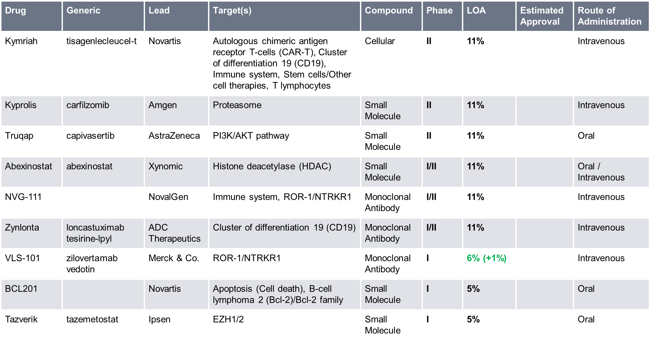
Pipeline Drugs in the US
For additional details on all pipeline candidates, from preclinical to preregistration, as well as suspended candidates, click here to view pipeline information on Biomedtracker.
Source: Biomedtracker 22 March 2024

Slide 26
Recent Events and Analyst Opinion
This is a snapshot of high-impact events that have occurred in the last 18 months for drugs in the MCL space in the curated Biomedtracker database. Analyst comments were provided by Pharma Intelligence’s global analyst team at the time of the event.
Venclexta for MCL (December 12, 2023)
Event Type: | Trial Data - Updated Results
Trial Name: | Phase III - SYMPATICO (w/Ibrutinib)
Lead Company: | AbbVie
Partner Companies: | Roche
Change to Likelihood of Approval: | 0%
Likelihood of Approval After Event: | 48% (4% above average)
Analyst Opinion
These are positive results from the SYMPATICO trial, which enrolled relapsed/refractory MCL patients and showed that Venclexta combined with Imbruvica beats placebo + Imbruvica on the primary endpoint of PFS (32 months vs. 22 months) as well as the secondary endpoints of complete response (CR) rate (54% vs. 32%) and time to next treatment (not reached vs. 35 months). However, following the withdrawal of Imbruvica's FDA accelerated approval for MCL in 2023 due to toxicity, the impact of this study will be largely restricted to geographies where Imbruvica retains approval as monotherapy for relapsed/refractory patients, such as Europe and Japan (in Japan, Imbruvica is also approved for first-line patients). SYMPATICO excluded patients who progressed on a BTK inhibitor, so this study does not address whether the combination can be used subsequent to a BTK inhibitor. Finally, after a median follow-up of 51 months, there was a numerical trend towards higher survival in the combination arm (median OS of 45 months vs. 39 months). However, the survival data are immature and longer follow-up is needed to see if there is a statistically significant improvement.
Compared to Imbruvica monotherapy, the combination of Venclexta + Imbruvica reported slightly higher rates of grade ≥3 adverse events (84% vs. 76%), especially neutropenia (31% vs. 11%), thrombocytopenia (13% vs. 8%), anemia (10% vs. 3%), leukopenia (7% vs. 0%), and diarrhea (8% vs. 2%). However, the rate of atrial fibrillation was the same in both arms at 5%, as was the rate of Imbruvica-related grade 5 adverse events at 2%. The rate of serious adverse events in both arms was 60%.
[continued on next slide]
Source: Biomedtracker 25 March 2024

Slide 27
Recent Events and Analyst Opinion
Analyst Opinion (continued)
Venclexta is also being studied in combination with other BTK inhibitors. TrAVeRse is a Phase II study that will evaluate Calquence combined with Venclexta and rituximab, while another Phase II study is evaluating Brukinsa combined with Venclexta and Gazyva. Both studies are enrolling first-line MCL patients.
BTK inhibitors have become an important part of MCL treatment and so the finding that combining a BTK inhibitor with Venclexta improves responses is significant. We expect that any path to US approval of Venclexta for MCL will lie with a second-generation BTK inhibitor. For now, we are leaving the LOA unchanged as we await a registration-enabling trial to initiate. While we expect regulatory submissions in the EU and Japan based on SYMPATICO, regulators may want to see a significant improvement in OS, which will require a longer follow-up of SYMPATICO patients.
Event detail in Biomedtracker: https://www.biomedtracker.com/EventDetail.cfm?EventID=502447
Source: Biomedtracker 25 March 2024

Slide 28
Recent Events and Analyst Opinion
Imbruvica for MCL (December 11, 2022)
Event Type: | Trial Data - Top-Line Results
Trial Name: | Phase III - TRIANGLE
Lead Company: | AbbVie
Partner Companies: | Johnson & Johnson / Royalty Pharma
Change to Likelihood of Approval: | 0%
Likelihood of Approval After Event: | 100% (Same as average)
Analyst Opinion
The introduction of Imbruvica to the R-CHOP/R-DHAP regimen for MCL patients under 65 years of age looks set to transform the first-line setting and offer the potential for these younger patients to forgo allogenic stem cell transplant (ASCT). These results from the Phase III TRIANGLE trial, which investigated the addition of Imbruvica to the standard of care regimen of R-CHOP/R-DHAP chemotherapy prior to ASCT, demonstrate the BTK inhibitor (BTKi) to significantly improve survival outcomes for patients. The study consisted of three arms: Arm A+I (comprising chemotherapy + Imbruvica followed by ASCT), Arm I (comprising chemotherapy + Imbruvica without ASCT), and Arm A (comprising the current standard treatment of chemotherapy + ASCT). The A+I arm demonstrated superiority in failure-free survival (FFS) compared to Arm A, with a three-year FFS rate of 88% vs 72% (HR = 0.52), outlining the addition of Imbruvica to add significant clinical benefit to the current standard of care therapy. More intriguingly, Arm A failed to show superiority over Arm I, indicating that ASCT added no survival benefit over Imbruvica maintenance without transplant. This marks the first time in which a small molecule tyrosine kinase inhibitor has prevailed against ASCT. The potential to negate ASCT for younger patients is particularly exciting as ASCT, although effective, is an aggressive treatment burdened with high toxicity. The Imbruvica maintenance regimen looks set to offer an alternative to transplant which allows for evasion of some of the associated ASCT toxicities, placing it as the new standard of care. While data are still awaited to decipher how the A+I and I regimens compare, these practice-changing results prime Imbruvica to transform the front-line setting for younger patients.
[continued on next slide]
Source: Biomedtracker 25 March 2024

Slide 29
Recent Events and Analyst Opinion
Analyst Opinion (continued)
Currently, Imbruvica is approved as a second-line therapy for MCL in the US under an accelerated approval. A label expansion into the front-line setting with the possibility to become the new standard of care would be another lucrative win for AbbVie's blockbuster BTKi. Something to be considered is the TRIANGLE study’s enrollment of younger patients, which may limit Imbruvica's potential uptake in this market. The average age of MCL patients at diagnosis is 65 years, thus a large proportion of the front-line setting is comprised of an elderly population. Despite Imbruvica demonstrating efficacy in elderly patients who are not suited for ASCT or intensive chemotherapy in the Phase III SHINE trial, the drug would still need to replicate the results of the TRIANGLE study in an older population who are fit for ASCT in order to boost its maximum uptake potential in the first-line setting. Patients under the age of 65 years also represent a population which is more tolerant of an aggressive ASCT regimen, therefore negation of transplant in an elderly population is an area of slightly higher unmet need. Nevertheless, these data from TRIANGLE are undoubtedly encouraging and warrant investigation of Imbruvica maintenance within an elderly population. Although the TRIANGLE study is academically sponsored, conducted by the European MCL Network and enrolling patients solely in European countries, considering the promising data, it can be expected that these results will most likely impact clinical practice around the globe.
Event detail in Biomedtracker: https://www.biomedtracker.com/EventDetail.cfm?EventID=463787
Source: Biomedtracker 25 March 2024

Slide 30
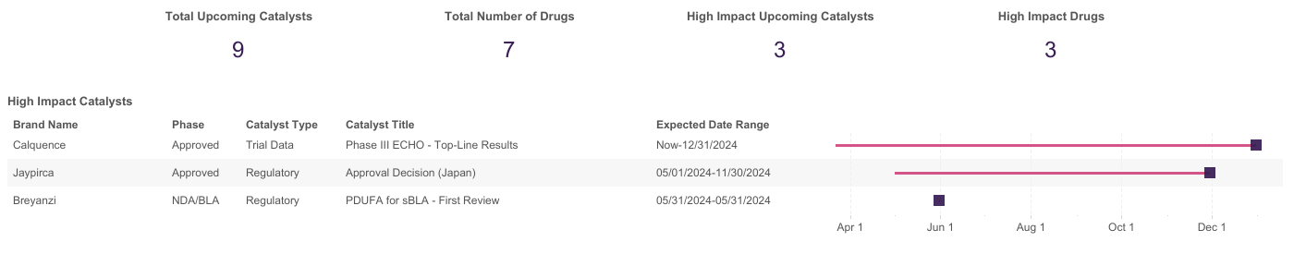
Key Upcoming Events
This is a snapshot of key upcoming events for drugs in the MCL space in the curated Biomedtracker database. High-impact upcoming events for drugs in the MCL space comprise topline Phase III trial results for Calquence, an expected PDUFA date for Breyanzi, and an estimated Japanese approval decision for Jayprica. Preclinical, Investigator Initiated, and IND candidates are not included here.
To view more details on upcoming catalysts on Biomedtracker, click here.
Source: Biomedtracker 21 March 2024

Slide 31
Key Regulatory Events
Bristol Myers Squibb Receives User Fee Goal Date For Breyanzi Iovance Biotherapeutics, Inc.'s polyclonal tumor infiltrating lymphocyte (TIL) cell therapy Amtagvi (lifileucel) worked its way through the US Food and Drug Administration’s Center for Biologics Evaluation and Research, emerging on 16 February with the first approval of an autologous T cell immunotherapy for a solid tumor cancer. CBER is also reviewing at least five new hematologic cancer indications for the marketed CAR-T therapies. Bristol Myers Squibb Company's CD19-directed Breyanzi (lisocabtagene maraleucel) accounts for three of them. Breyanzi has a 14 March goal date for chronic lymphocytic leukemia or small lymphocytic leukemia patients after BTK inhibitor and BCL2 inhibitors; a 23 May goal for relapsed or refractory follicular lymphoma; and a 31 May goal date for relapsed or refractory mantle cell lymphoma after a BTK inhibitor. Pink Sheet February 2024
Source: Pink Sheet

Slide 32
Key Regulatory Events
Kite’s Tecartus Boxed Warning Will More Closely Resemble Other CAR-Ts After FDA Changes Course Kite Pharma, Inc.’s CAR-T therapy Tecartus will remain an outlier among its peers when new safety labeling on secondary malignancy is in place, but will be much less of one after a quick change by the US Food and Drug Administration. Officials in the Center for Biologics Evaluation and Research had released mandates to the sponsors of six CAR-T therapies indicated for various cancers, including Tecartus (brexucabtagene autoleucel), on 22 January demanding boxed warnings and other labeling sections be updated to include the risk of secondary malignancy. While the update requested was largely the same for five products – Celgene’s Abecma, Juno’s Breyanzi, Janssen’s Carvykti, Novartis’s Kymriah, and Kite’s Yescarta – the Tecartus language was less affirmative in warning against secondary malignancy. CBER changed that on 24 January when it pulled the original letter from its website and released an updated version with different language for Kite to add. Instead of stating that “T cell malignancies may occur following treatment with BCMA- and CD19-directed genetically modified autologous T cell immunotherapies, including Tecartus,” in the boxed warning highlights section, Kite now must write “T cell malignancies have occurred following treatment with BCMA- and CD19-directed genetically modified autologous T cell immunotherapies.” The labeling updates for the five other products adds “including [product name]” at the end of the sentence. Similar changes from “may occur” to “have occurred” were made to the updates in the Tecartus boxed warning in the full prescribing information, as well as the Warnings and Precautions and Patient Counseling Information sections. Also changed was an apparent formatting error that would have required the entire statement on secondary malignancies in the Warnings and Precautions section of the label highlights to be underlined. The updated letter only requires the first two words, “secondary malignancies,” to be underlined. No other items in that section are underlined in the current label, but the five other letters also include the same underlined text. Left unchanged is the Postmarketing Experience section language, which states that T cell malignancies have been identified during postmarketing use of BCMA- and CD19-directed genetically modified autologous T cell immunotherapies. Unlike the five other product labeling updates, the FDA did not mandate that statement specifically say that secondary malignancies had been found in postmarketing use of Tecartus. Pink Sheet January 2024
Source: Pink Sheet

Slide 33
Key Regulatory Events
Jaypirca Receives Approval In EU The Pink Sheet’s regularly updated list of products containing new active substances that have been approved for marketing in the EU under the centralized authorization procedure now includes two new products – Jaypirca and Vanflyta. Eli Lilly’s Jaypirca (pirtobrutinib) is approved for use as monotherapy for the treatment of adult patients with relapsed or refractory mantle cell lymphoma who have been previously treated with a Bruton’s tyrosine kinase inhibitor. Pink Sheet November 2023
CHMP Recommends Jaypirca For Approval Arexvy (recombinant, adjuvanted), from GSK, has moved closer to becoming the first vaccine authorized to help protect older adults from respiratory syncytial virus (RSV) disease, after the European Medicines Agency recommended that the product be approved for marketing across the EU. The remaining products that received a positive opinion from the CHMP were Bristol Myers Squibb’s Camzyos (mavacamten), Eli Lilly’s Jaypirca (pirtobrutinib), Taiho Pharmaceutical’s Lytgobi and a generic sugammadex product from Piramal Critical Care, Sugammadex Piramal. Jaypirca is Eli Lilly’s treatment for relapsed or refractory mantle cell lymphoma. The CHMP recommended that the drug receive a conditional marketing authorization. Jaypirca was approved in the US in January, when Lilly said it had become the first non-covalent (reversible) BTK inhibitor for adult patients with relapsed or refractory MCL after at least two lines of systemic therapy, including a BTK inhibitor. Columvi, Jaypirca and Lytgobi were granted EU orphan drug status during their development. Orphan designations are reviewed by the EMA's Committee for Orphan Medicinal Products at the time of approval to determine whether the information available to date allows orphan status to be maintained and 10 years of market exclusivity to be granted. Pink Sheet April 2023
Source: Pink Sheet

Slide 34
Key Regulatory Events
AbbVie/J&J Withdrawal Of Imbruvica Indications Clears Space For Competitors The loss of two indications for AbbVie Inc. and Johnson & Johnson’s Imbruvica (ibrutinib), for mantle cell lymphoma (MCL) and marginal zone lymphoma (MZL), are relatively small markets for the BTK inhibitor, but their withdrawal from Imbruvica’s label potentially clears the way for newer BTK inhibitors, provided their confirmatory trials are more successful. The Janssen Pharmaceutical Companies of J&J and AbbVie’s Pharmacyclics subsidiary said 6 April said they would voluntarily withdraw the US indications for Imbruvica in MCL patients who have at least one prior therapy, which gained accelerated approval in 2013, along with MZL in patients who require systemic therapy and have received at least one prior therapy with CD20-targeted monoclonal antibody treatment, which followed in 2017. The companies said they had made the decision after consulting with the US Food and Drug Administration, which said the outcomes of the confirmatory Phase III SHINE study in frontline MCL and the SELENE story in relapsed/refractory MZL and follicular lymphoma (FL) were insufficient to support full approval. Results of SHINE presented at the American Society of Clinical Oncology meeting in June 2022 and published in The New England Journal of Medicine showed that while Imbruvica significantly improved progression-free survival (PFS), it did show an overall survival (OS) advantage. SELENE, meanwhile, did not meet its primary endpoint of PFS in MZL or FL. Scrip April 2023
Source: Scrip

Slide 35
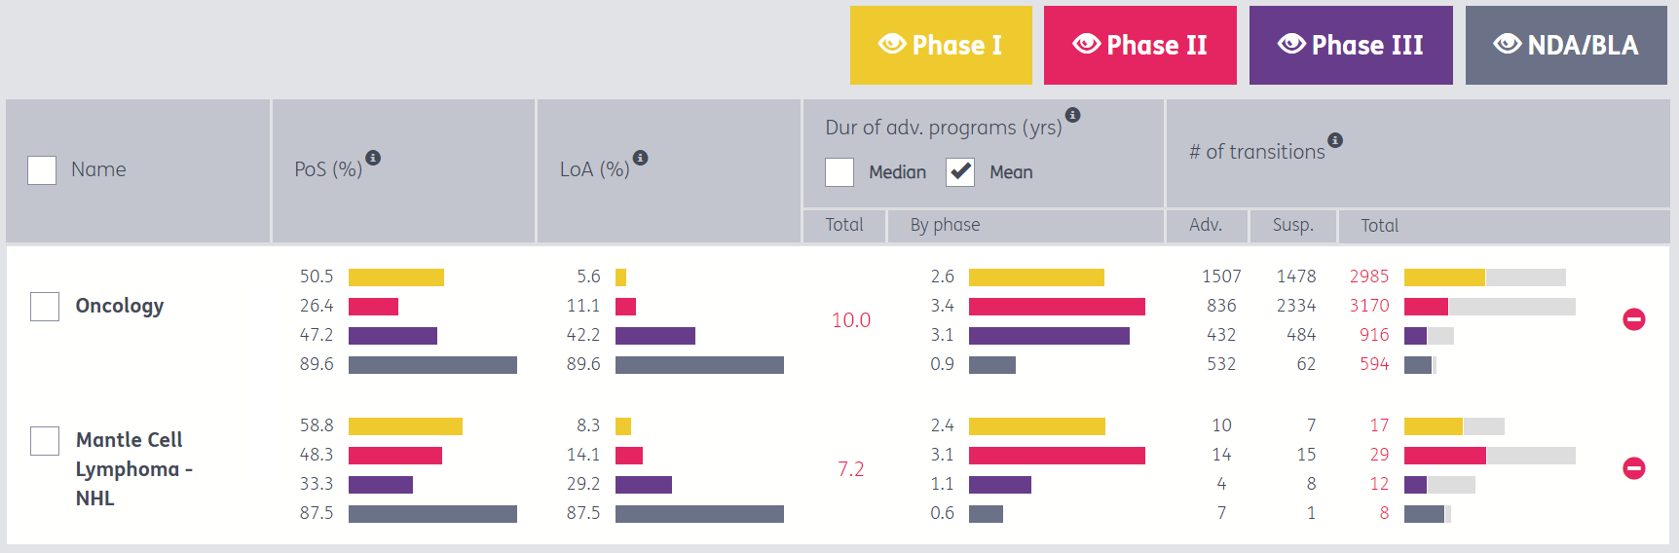
Probability of Success
This is a snapshot of probability of success and likelihood of approval, by trial phase, in the MCL space in the curated Pharmapremia database. The overall likelihood of approval of a Phase I MCL asset is 8.3%, and the average probability a drug advances from Phase III is 33.3%. Drugs, on average, take 7.2 years from Phase I to approval, compared to 10.0 years in the overall oncology space.
To view more details in Pharmapremia to help you identify opportunities and manage portfolio risk, click here.
PoS = Probability of Success a drug advances from the current phase; LoA = Likelihood of Approval from current phase; Dur. of adv. programs (yrs) = average cycle time a drug is in this phase, in years; # of transitions = # of drug programs that advanced or were suspended in this phase
Source: Pharmapremia 25 March 2024

Slide 36
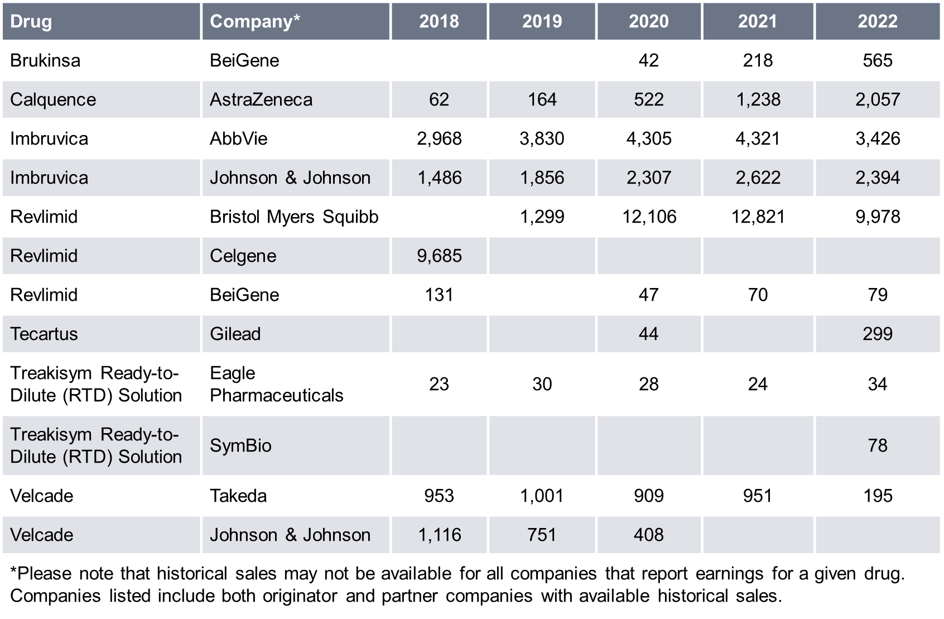
Revenue Opportunity
This is a snapshot of historical and forecasted sales of drugs in the MCL space in the curated Biomedtracker database. The sales included here are total brand sales and not necessarily disease-specific. The forecasted sales are based on a consensus of a minimum of three analyst reports from major investment banks.
Historical
Global Sales
($m)
Historical 2023 sales revenues will be available in Q2 2024 once they have been reported by the respective companies.
Source: Biomedtracker 24 March 2024

Slide 37
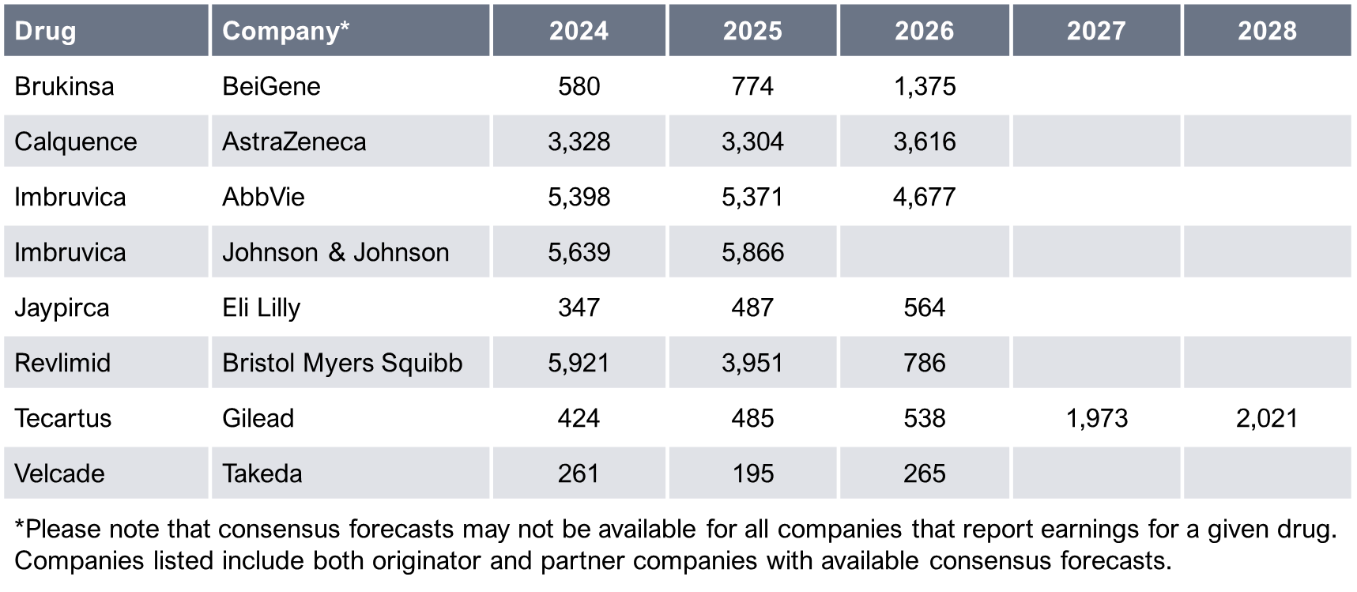
Revenue Opportunity
Forecasted
Global Sales
($m)
Source: Biomedtracker 24 March 2024

Slide 38
Clinical Trial Landscape

Slide 39
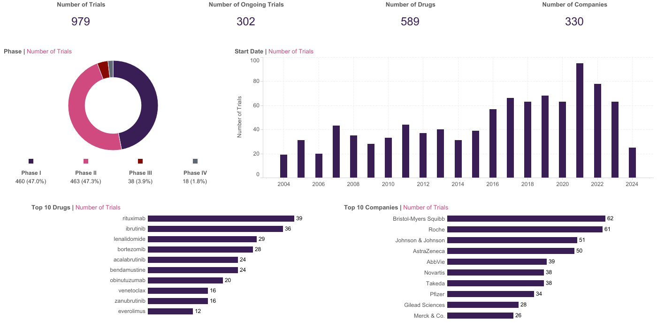
Clinical Trials
This is a snapshot of Phase I–IV clinical trials for primary investigational drugs with at least one industry sponsor in the MCL space in the curated Trialtrove database. The distribution of clinical trials across Phase I–IV indicates that the vast majority of trials for MCL have been in the early and mid-phases of development, with 94% of trials in Phase I–II, and only 6% in Phase III–IV. Phase I/II and Phase II/III trials are counted as Phase II and Phase III, respectively.
Source: Trialtrove 22 March 2024

Slide 40
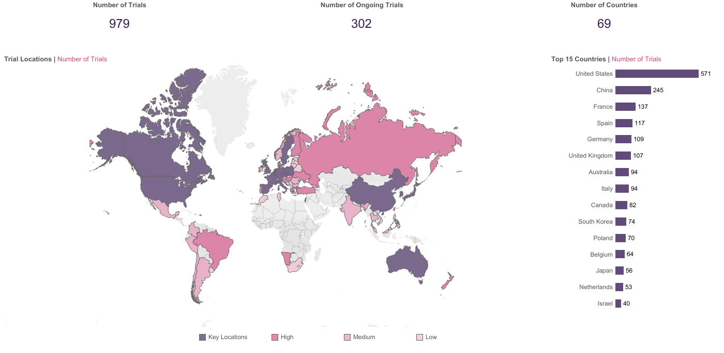
Clinical Trials
This is a snapshot of Phase I–IV clinical trials for primary investigational drugs with at least one industry sponsor in the MCL space in the curated Trialtrove database. The US has a substantial lead in the number of MCL clinical trials globally. France leads the major European markets, while China has the top spot in Asia.
Source: Trialtrove 22 March 2024

Slide 41
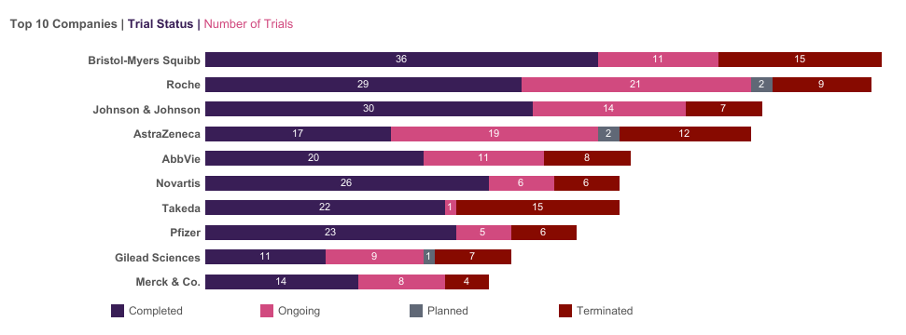
Clinical Trials – Sponsors by Status
This is a snapshot of Phase I–IV clinical trials for primary investigational drugs with at least one industry sponsor in the MCL space in the curated Trialtrove database. Bristol Myers Squibb has the highest number of completed clinical trials for MCL, with 36 trials.
Source: Trialtrove 22 March 2024

Slide 42
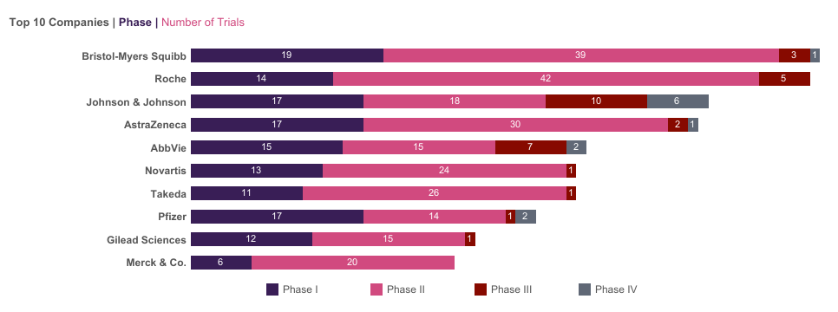
Clinical Trials – Sponsors by Phase
This is a snapshot of Phase I–IV clinical trials for primary investigational drugs with at least one industry sponsor in the MCL space in the curated Trialtrove database. Bristol Myers Squibb leads industry sponsors with the highest overall number of clinical trials for MCL, closely followed by Roche.
Source: Trialtrove 22 March 2024

Slide 43
Bibliography
Ben Barouch et al., 2020
Cancer Research UK, 2020
Centers for Disease Control and Prevention, 2018
Cheah et al., 2016
Cheson et al., 2014
Fakhri and Kahl, 2017
FDA, 2017
FDA, 2019
FDA, 2020
FDA, 2023
Ferlay et al., 2018
GARD, 2016
Herrero-Vicent et al., 2016
Khanna et al., 2017

Slide 44
Bibliography
Leukemia & Lymphoma Society, 2018
Lymphoma Action, 2021
Lymphoma Research Foundation, 2021
Lynch et al., 2021
Maddocks, 2018
Martin et al., 2017
McKay et al., 2018
National Cancer Institute, 2018
Nazeef and Kahl, 2015
NCCN, 2023
NORD, 2021
Shrestha et al., 2015
United Nations, 2017
Wang and Ma, 2014

Slide 45
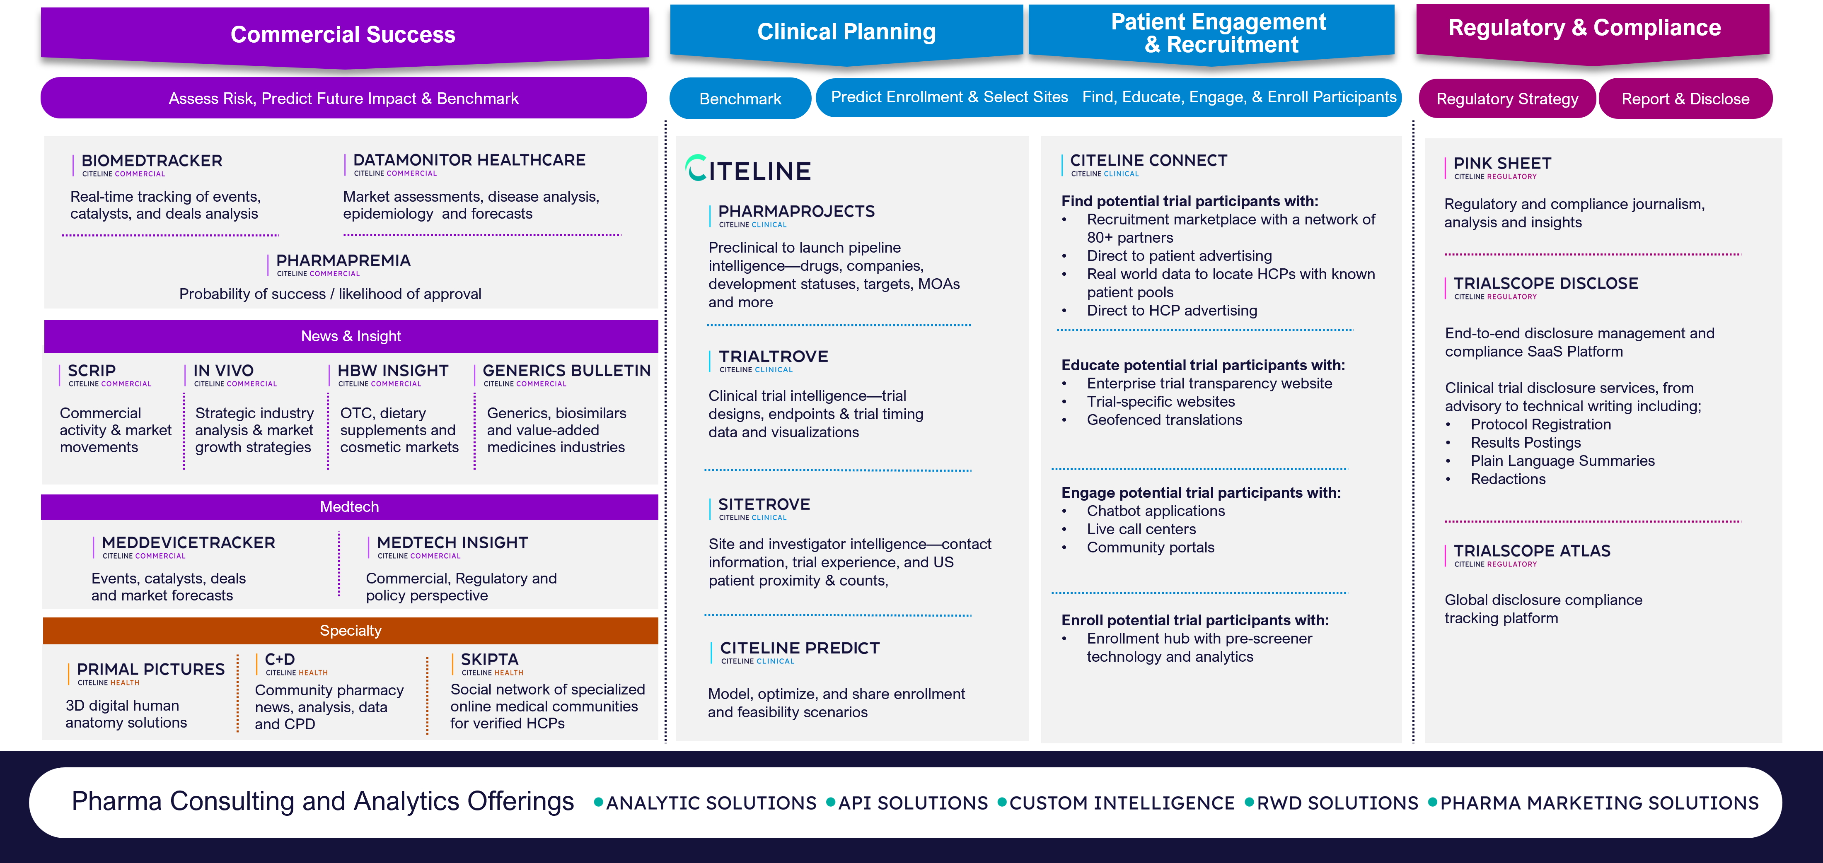
Citeline Portfolio

Slide 46
Appendix
Relying on Pharma Intelligence to deliver vital advantage when making critical R&D and commercial decisions, our customers come from over 3,000 of the world’s leading pharmaceutical companies, contract research organizations (CROs), and medical technology, biotechnology, and healthcare service providers, including top 10 global pharma companies.
From drug and device discovery and development to regulatory approval, and from product launch to lifecycle management, we provide the intelligence and insight to help our customers seize opportunities, mitigate risk, and make business-critical decisions, faster.
As the pharma and healthcare sector faces unparalleled upheaval, customers rely on our independent advice, enabling them to cut through the clutter and make sense of changing drug developments, as well as regulatory and competitive landscapes.
From early-phase and portfolio decisions to clinical R&D and commercial planning and analysis, our offering includes a suite of complementary subscription news, data, and analysis services, as well as expert analyst reports and consulting capabilities from the world’s leading pharma and healthcare R&D and business intelligence brands.
For more information, visit https://www.citeline.com/.

Slide 47
Disclaimer
Copyright © 2024 Pharma Intelligence
This report is published by Pharma Intelligence (the Publisher). This report contains information from reputable sources and although reasonable efforts have been made to publish accurate information, you assume sole responsibility for the selection, suitability and use of this report and acknowledge that the Publisher makes no warranties (either express or implied) as to, nor accepts liability for, the accuracy or fitness for a particular purpose of the information or advice contained herein. The Publisher wishes to make it clear that any views or opinions expressed in this report by individual authors or contributors are their personal views and opinions and do not necessarily reflect the views/opinions of the Publisher.

